Slide 1

Green Pace
Security Policy Presentation
Developer: Wesley Blackwell

Slide 2

OVERVIEW: DEFENSE IN DEPTH
The security policy states the standards and best practices for Green Pace. Each part of this policy make up the layers of Defense in Depth.

Slide 3
THREATS MATRIX
Likely STD-002-CPP STD-003-CPP STD-004-CPP STD-005-CPP STD-007-CPP STD-008-CPP STD-010-CPP | Priority
Low priority STD-006-CLG | Unlikely STD-001-CPP STD-009-CPP
Low priority is unlikely to happen with low severity.
Likely means probable to happen with a low severity.
Unlikely means unlikely to happen with high severity.
Priority means likely to happen with high severity.

Slide 4
10 PRINCIPLES
Validate Input Data
STD-002-CPP, STD-004-CPP
Heed Compiler Warnings
STD-003-CPP, STD-005-CPP, STD-006-CLG, STD-010-CPP
Architect and Design for Security policies
STD-001-CPP, STD-008-CPP
Keep it Simple
STD-001-CPP, STD-002-CPP, STD-008-CPP, STD-009-CPP
Default Deny
STD-005-CPP
Adhere to the Principle of Least Privilege
STD-005-CPP
Sanitize Data Sent to Other Systems
STD-004-CPP
Practice Defense in Depth
Use Effective Quality Assurance Techniques
STD-005-CPP, STD-007-CPP
Adopt Secure Coding Standard
STD-001-CPP, STD-002-CPP, STD-004-CPP, STD-006-CLG, STD-007-CPP, STD-008-CPP, STD-010-CPP

Slide 5
CODING STANDARDS
Obey the one-definition rule
Do not read uninitialized memory
Do not attempt creating an std::string from a null pointer
Prevent SQL injection
Don’t access freed memory
Use static assertions to test the value of constant expressions
Don’t terminate the program abruptly
Be sure to use valid iterating ranges
Write constructors that initialize variables, or objects, in canonical order
Don’t access objects outside of their life cycle

Slide 6
ENCRYPTION POLICIES
At Rest
This type of encryption refers to data in storage being unreadable without the encryption key. This means that in the event that this data was stolen, the attacker could not read the data without the key.
In Transit, or In Flight
This type of encryption refers to data traveling from one device to the next. This encryption protects the data from being read if it gets taken during transmission
In Use
This type of encryption refers to data that is being used by a system. Encryption is used to keep the data secure at all times, and even when it is being changed.

Slide 7
TRIPLE-A POLICIES
Authentication
This refers to the process of verifying the identity of the user though credentials like username and passwords.
Authorization
This refers to the level of accessibility a user has to the system based on their system role. This policy keeps the system safe by restricting users access to parts of the system they have no need to use.
Accounting
This process tracks and logs all requests and transactions made by users of a system. This policy is important because it allows investigators access to timestamped logs of each action performed on the system by any user.

Slide 8
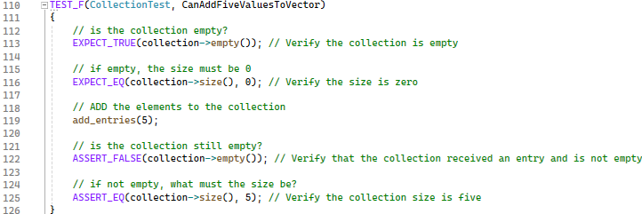
Can Add Values To A Vector

Slide 9
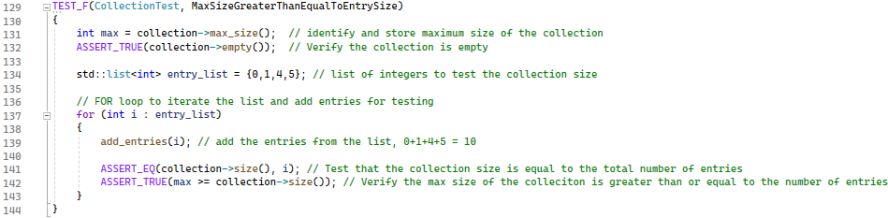
Max is Greater Than the Entry Size

Slide 10
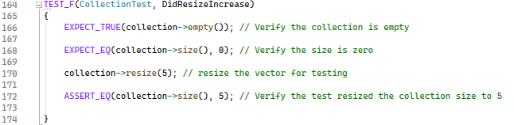
Did the Size Increase

Slide 11
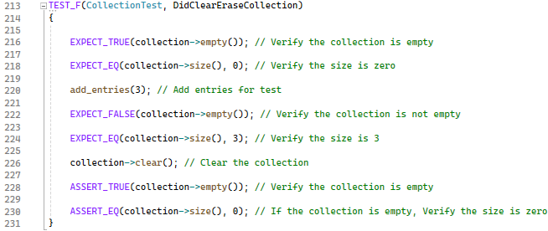
Did Clear Erase the Collection

Slide 12
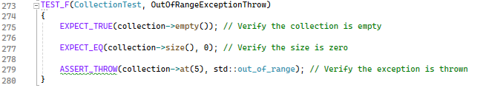
Is an Exception Thrown

Slide 13

AUTOMATION SUMMARY

Slide 14
TOOLS
The DevSecOps pipeline shows the flow of the development process
Pre-production: Steps to design, steps to test the system
Production: Steps for deployment, monitoring, and maintaining the system
Design Stage: OWSAP, or Security Policy for the creation of a secure system design
Build Stage: IDE/Compiler for compiling, debugging, and executing the code
Verify and Test Stage: Unit tests and static analysis tools
Monitor and Detect Stage: Timestamping, logging, and application monitoring

Slide 15
RISKS AND BENEFITS
When should security be implemented?
Immediately and in every step of development
Security of your system and all data is serious and must be treated as such.
Benefits
Security is easier and less costly when implemented throughout each stage of development.
The resulting code will be more robust, reliable, and consistent.
Risks
More costly to wait for security implementation: Architecture and vulnerabilities.
Increased potential of breach due to increase in potential vulnerability

Slide 16
RECOMMENDATIONS
Human error is always a potential threat to the system: Security policies do no good if they are not understood and followed closely.
Developers should be trained and educated on this security policy and receive DevSecOps training.
Accounting is important to the security of a system.
Automated monitoring for vulnerabilities allows developers to actively monitor the system to provide security updating through patching.

Slide 17
CONCLUSIONS
Security should always be a focal point whenever developing or updating a system.
Talk about security plans during each planning meeting.
What are we trying to do and how do we make it secure?
Provide effective security and security policy training for developers
Accountability and enforcement
The deployment of a system should not take place without practical and functional methods of operation and monitoring.
The security policy should have routine revisits by the team to ensure it is adequate for the current status of the business and system.

